Slide 1
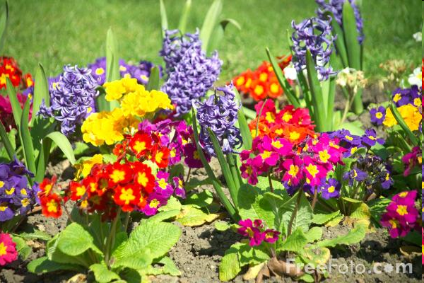
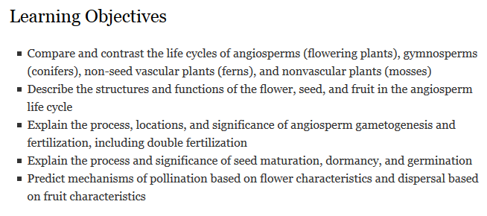
Reproduction in Flowering Plants

Slide 2


Slide 3
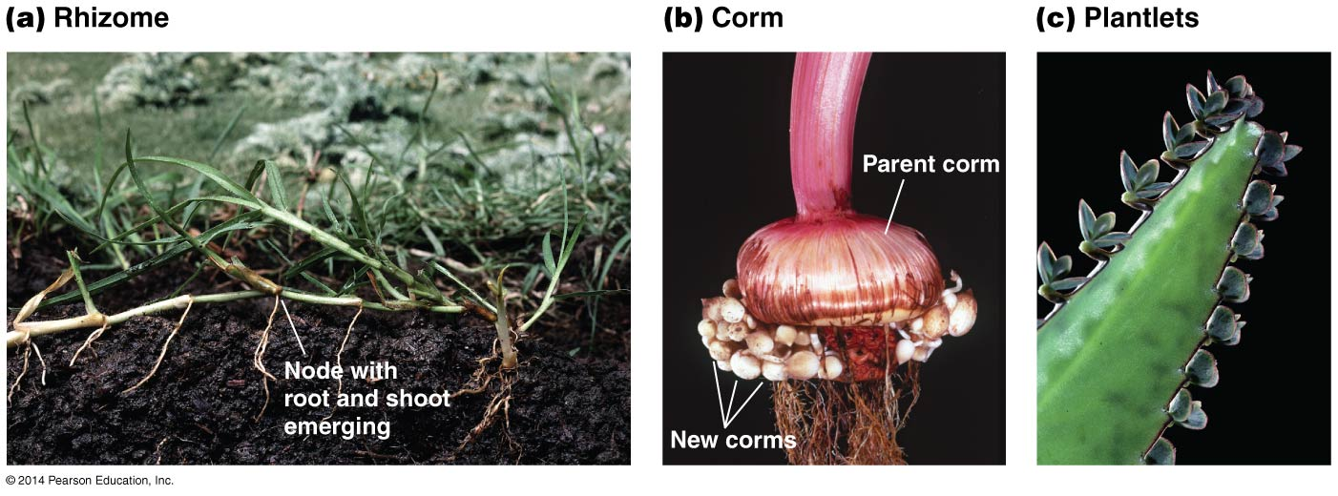
Asexual reproduction in plants
Notes:
Stem, stem, leaf
Sporophyte

Slide 4
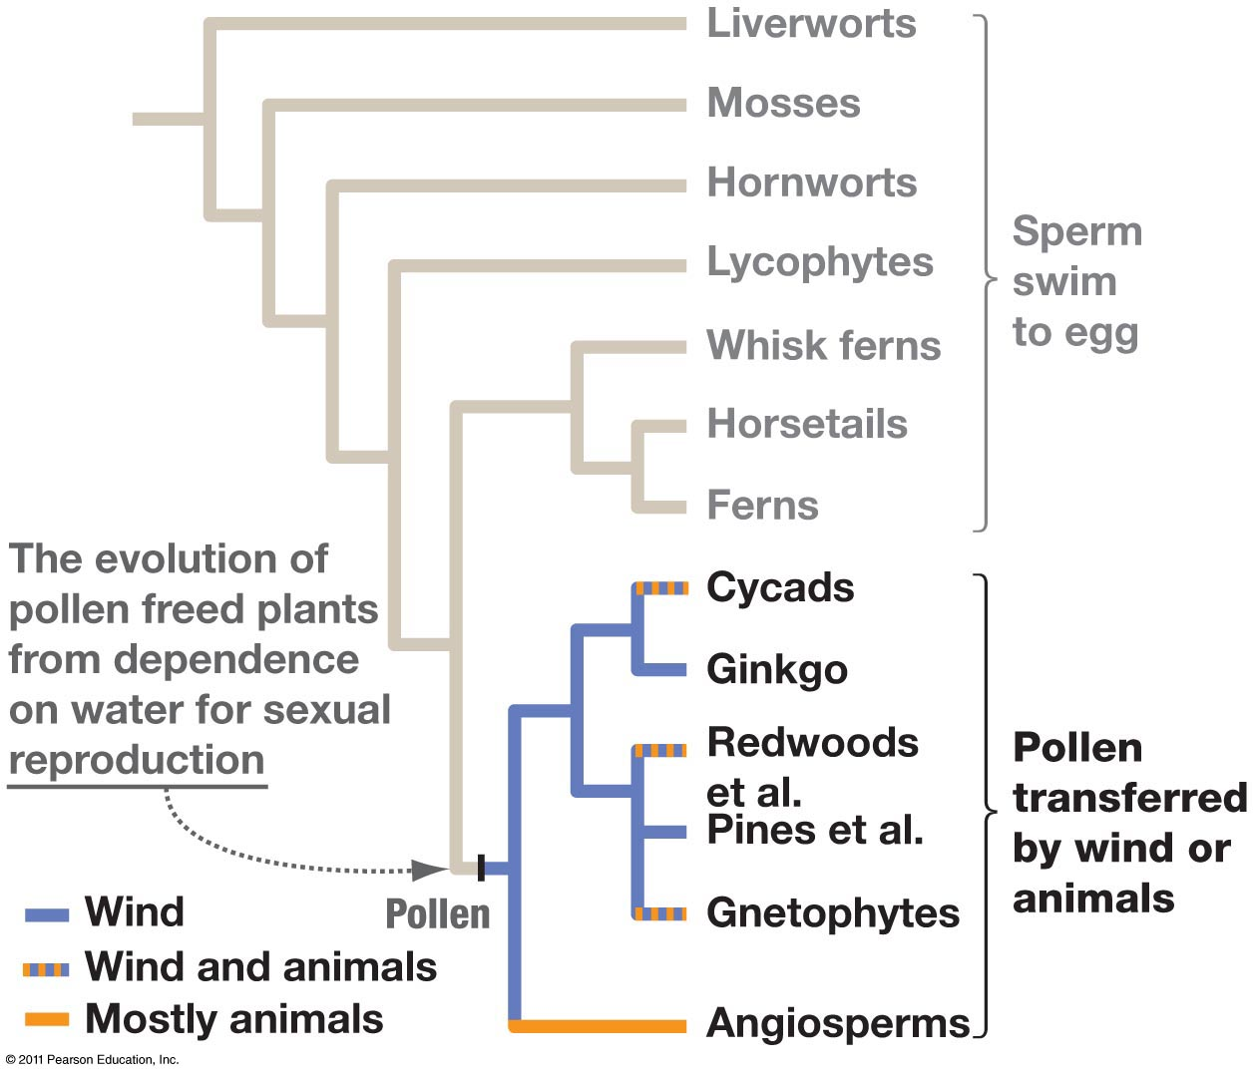

Slide 5
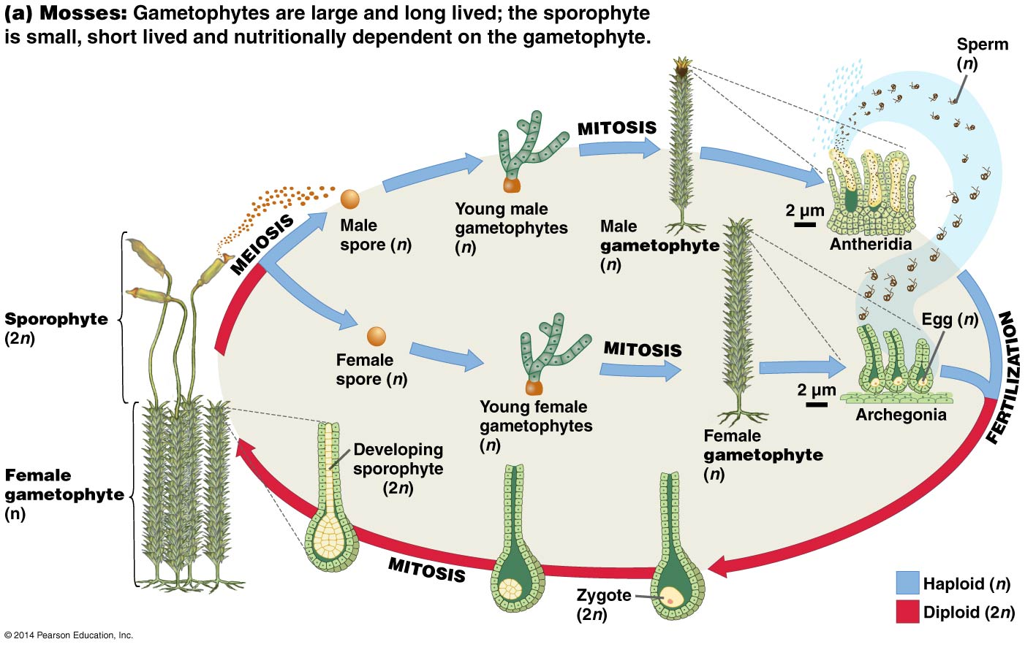

Slide 6
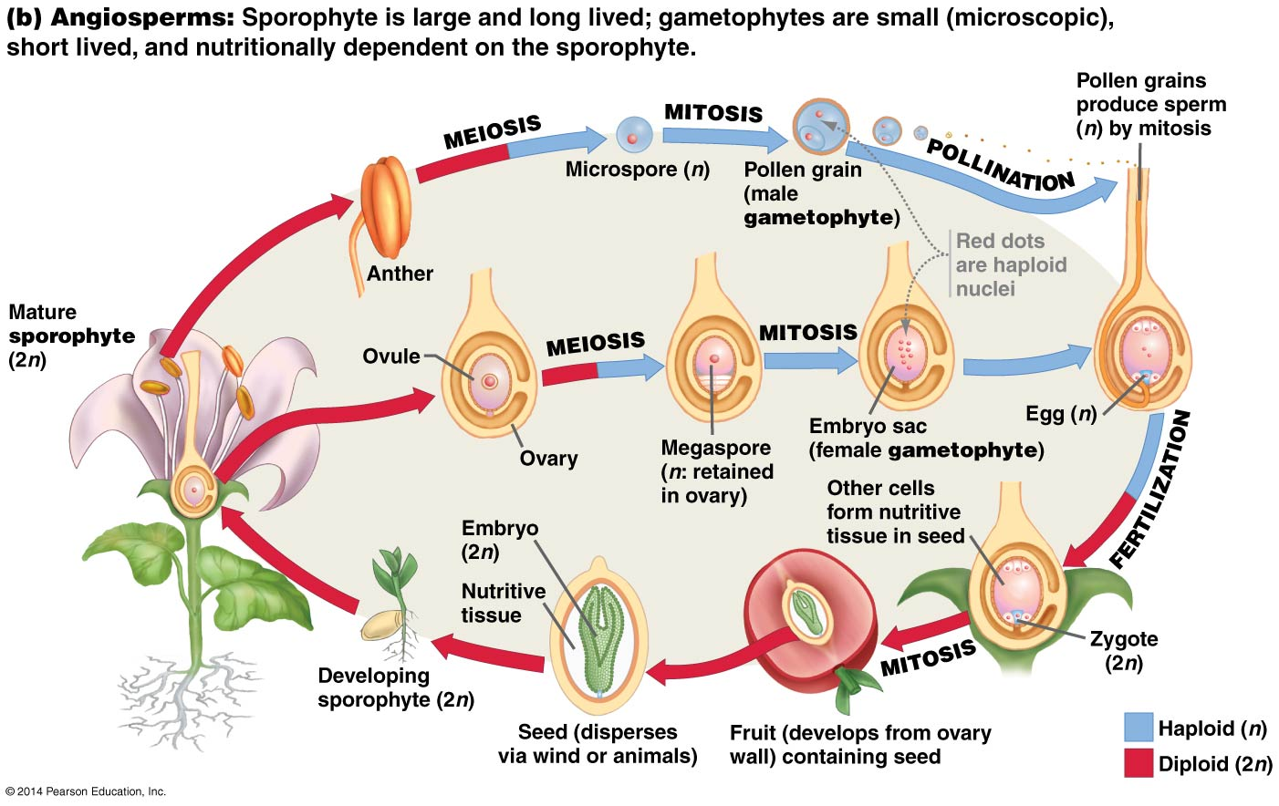
Notes:
Angiosperms: seed plants; heterospory (two distinct types of spores produced by two different structures – ultimately producing male and female gametophytes); seeds as dispersal for sporophyte rather than spores for dispersal of gametophyte (in seedless plants); flowers for pollination (fertilization of gametes); fruits for dispersal of seed (sporophyte embryo); double fertilization to create triploid endosperm; coevolution between flowers and pollinators

Slide 7
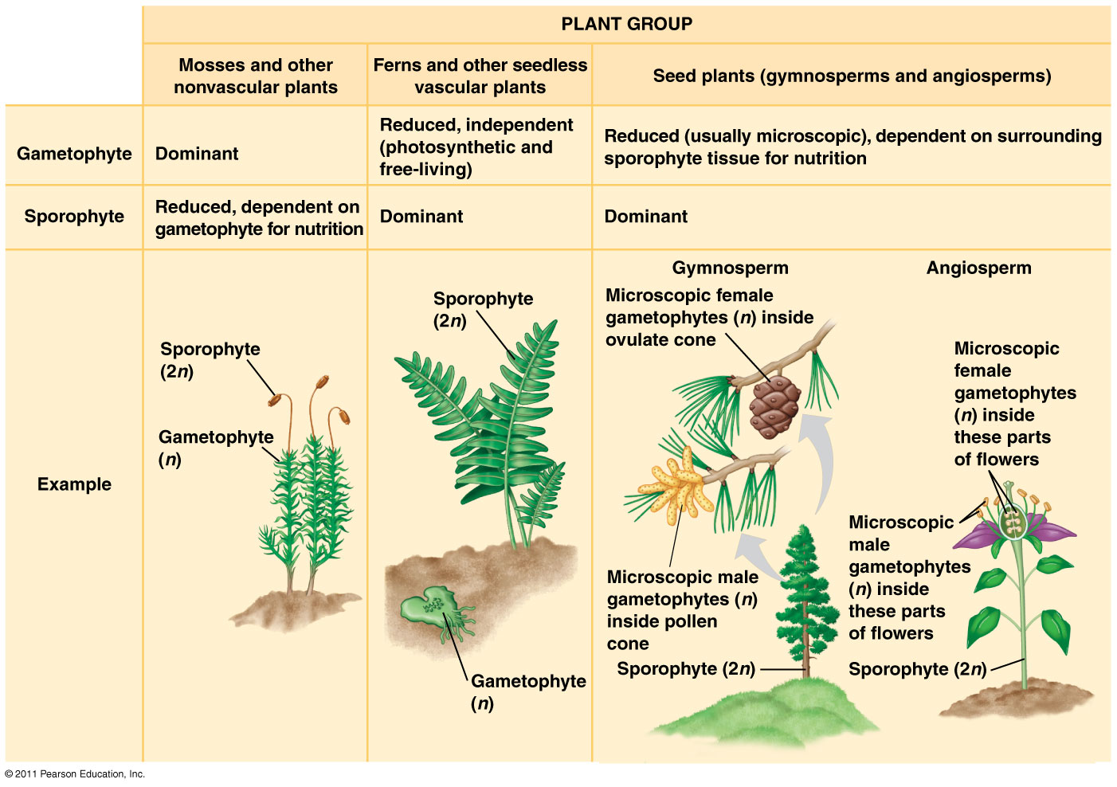
Notes:
Summary for your reference

Slide 8
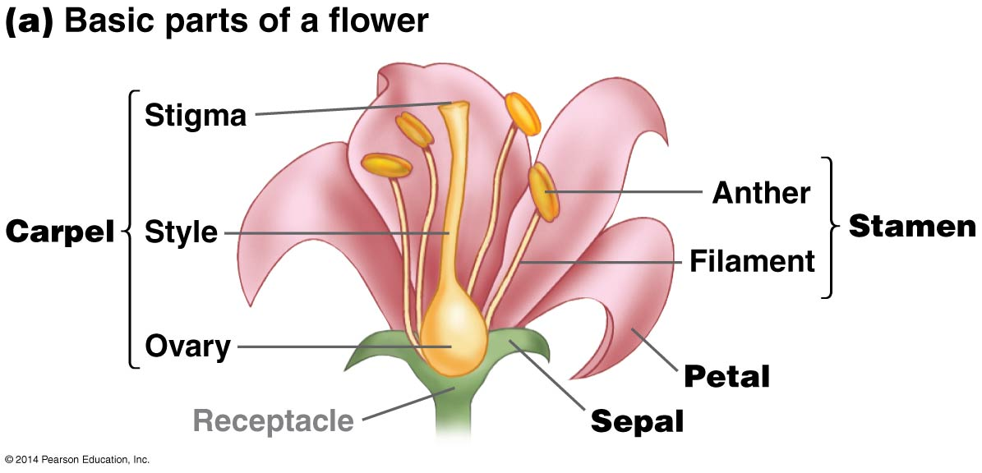
Flower structures

Slide 9
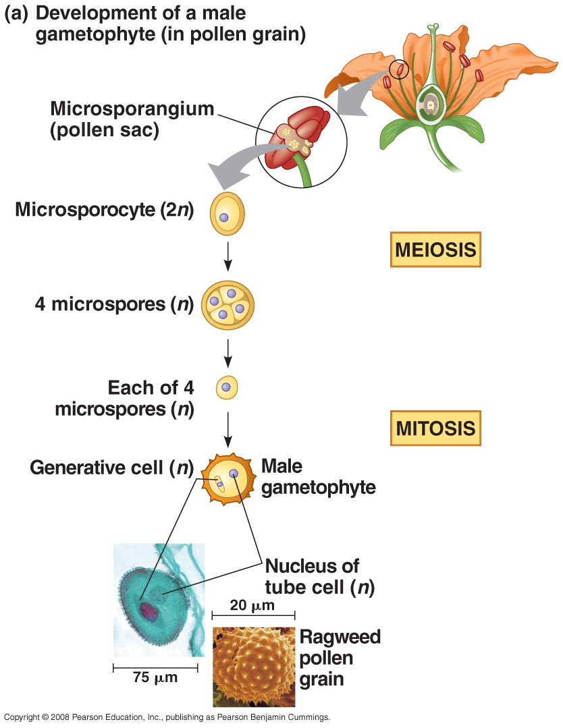
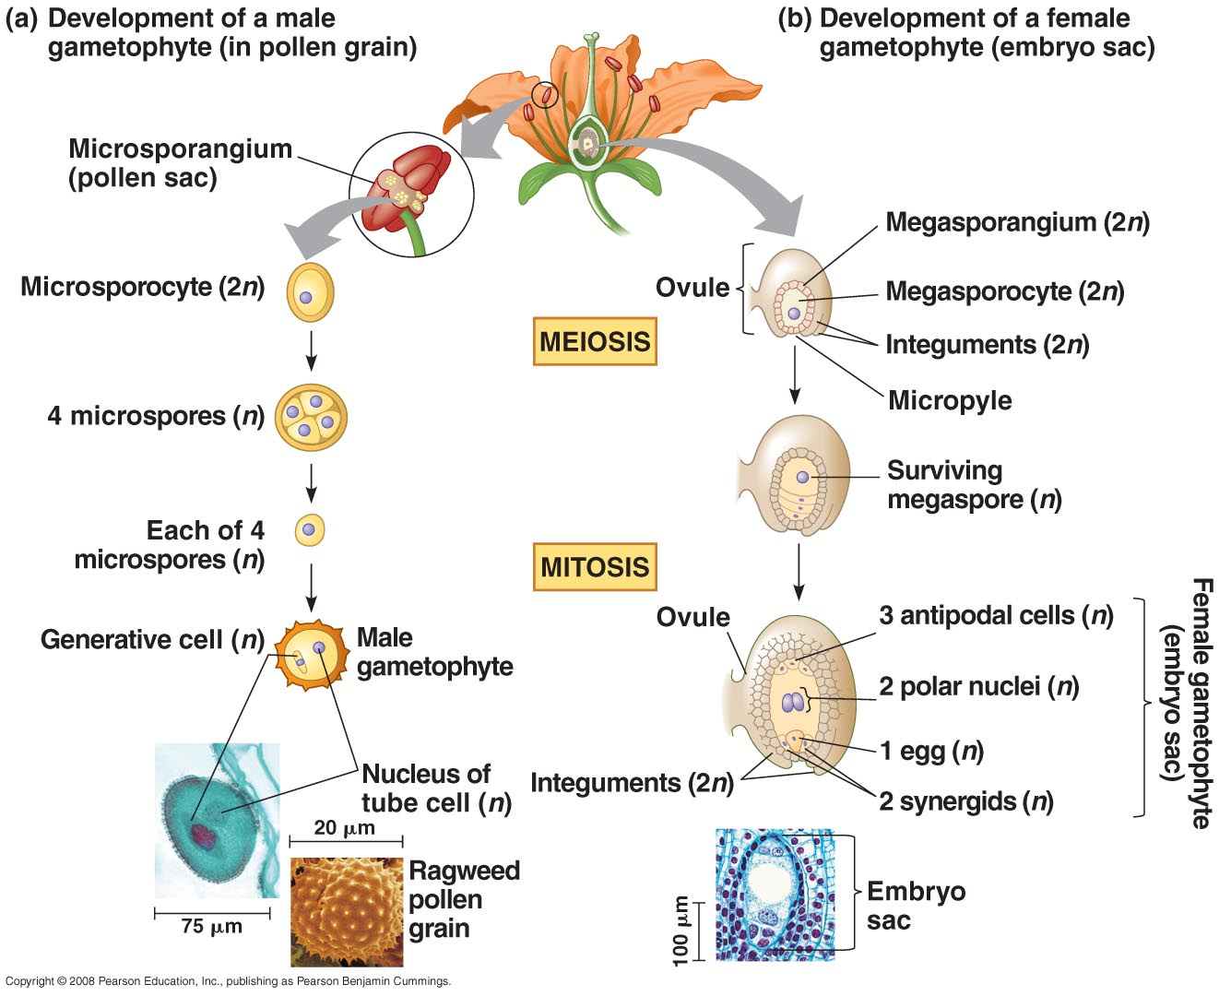
Angiosperm Gametophytes
Sporophyte produces spores
sporocytes undergo meiosis to produce spores
spores produce gametophytes through mitosis
gametophytes produce gametes
Campbell & Reece, Fig. 38.02
Notes:
9

Slide 10
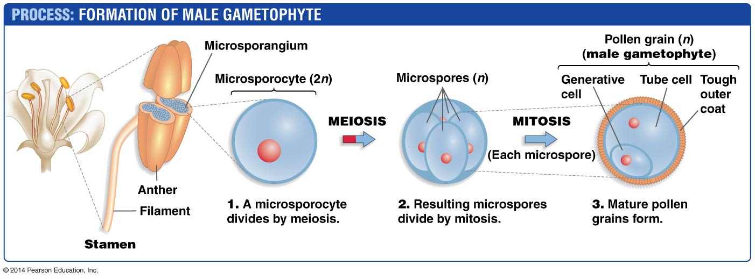
Angiosperm male gametophyte
What is the relationship between the sperm, the microspore, the pollen, the male gametophyte, and the microsporocyte?
How many gametophytes are produced from one microsporocyte?
Notes:
Microsporocyte produces microspore, which develops into male gametophyte, which is pollen, which produces sperm (2 sperm from each pollen grain)

Slide 11
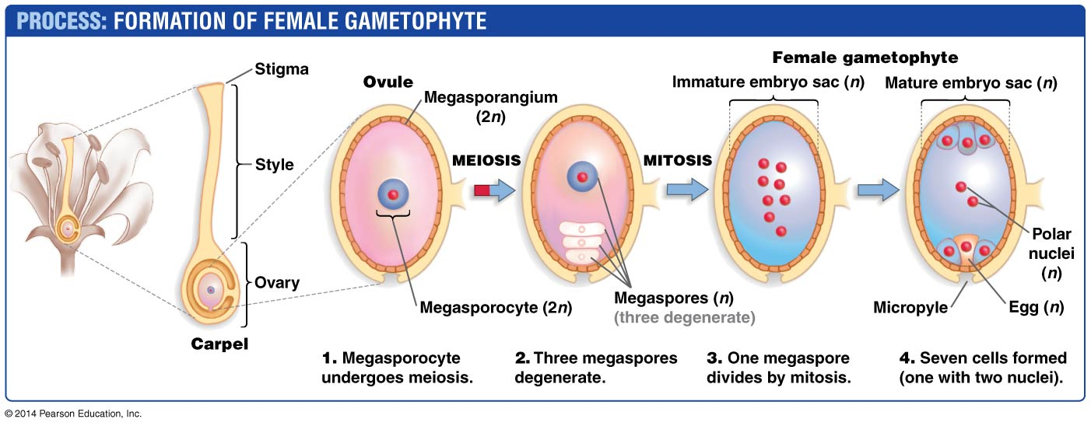
Angiosperm female gametophyte
What is the relationship between the egg, the megaspore, the embryo sac, the female gametophyte, and the megasporocyte?
How many female gametophytes are produced from one megasporocyte?
Notes:
egasporocyte produces megaspore, develops into female gametophyte, which is embryo sac, which produces the egg; 1 egg from each embryo sac

Slide 12
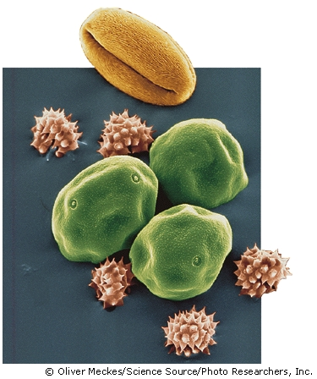
Pollination (movement of the pollen grain)
Self fertilization (direct contact):
anther and stigma in same flower
Cross pollination (outcrossing):
Wind-pollinated flowers have sticky or feather-like stigmas and they produce pollen grains in great number
Water carriage: water moves pollen
Animal, bird, insect vectors
Cherry Pollen
Hornbeam Pollen
Daisy Pollen
Notes:
Cherry – insects, esp bees
Hornbeam – wind
Daisy - bee

Slide 13
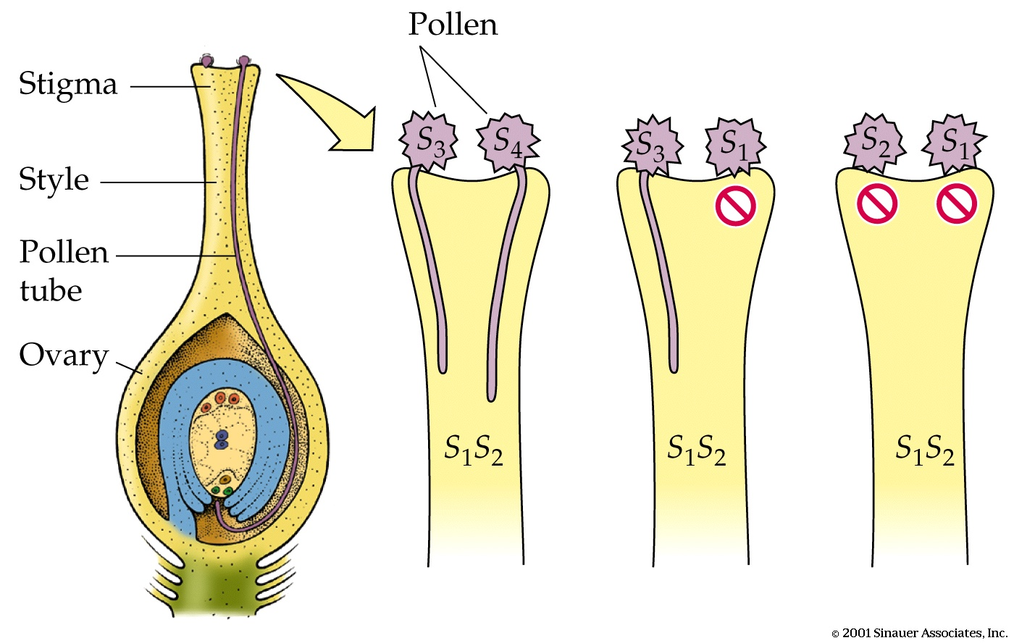
Pollen Selection (“Mate Selection”)
Temporal avoidance
male and female gametophytes mature at different times
Spatial avoidance
male and female gametophytes are too far apart
Molecular matching: In self-incompatible species the stigma rejects pollen from its own flowers (promotes variation, limits inbreeding)
S gene is responsible for selection; has dozens of alleles
The haploid pollen grain has one S gene, recipient stigma is diploid and has two S genes
In self-incompatible plants, pollen fails to develop or develops abnormally
…but S₁ and S₂ pollen do not germinate. They are self-incompatible
S₃ and S₄ pollen are compatible with S₁S₂ stigma…
Notes:
1: S3 or S4
2: S3/4 and S1/2
3: S1/2 and S1/2

Slide 14
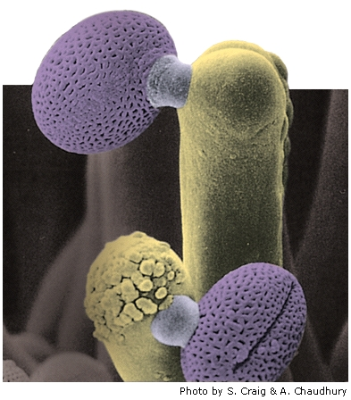
A Pollen Tube Delivers Male Cells to the Embryo Sac
Pollen tube beginning to grow
When a pollen grain lands, it germinates to form a pollen tube
The pollen tube digest its way through the spongy tissue of the style
Rapid growth of pollen tube requires Ca⁺⁺ ions, taken up from stigma
Downward pollen tube growth is directed by signals from the ovule (synergid cells)
Pollen
Stigma of Arabidopsis flower

Slide 15
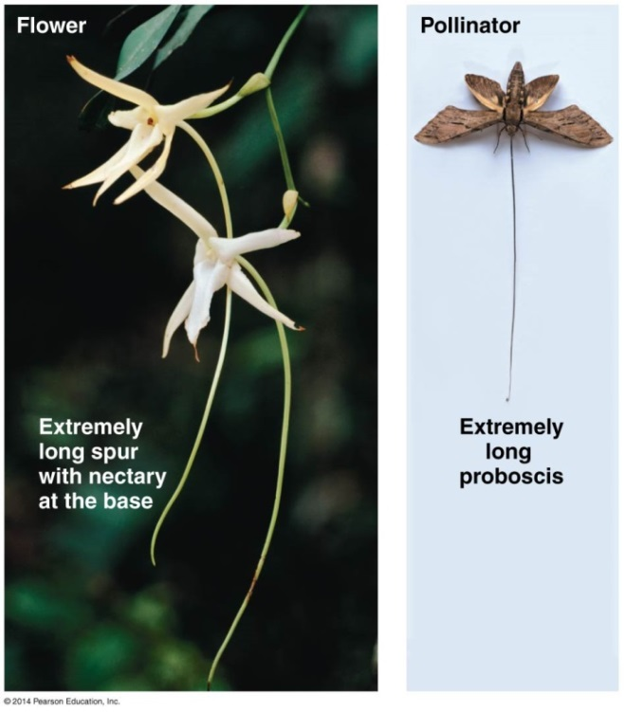
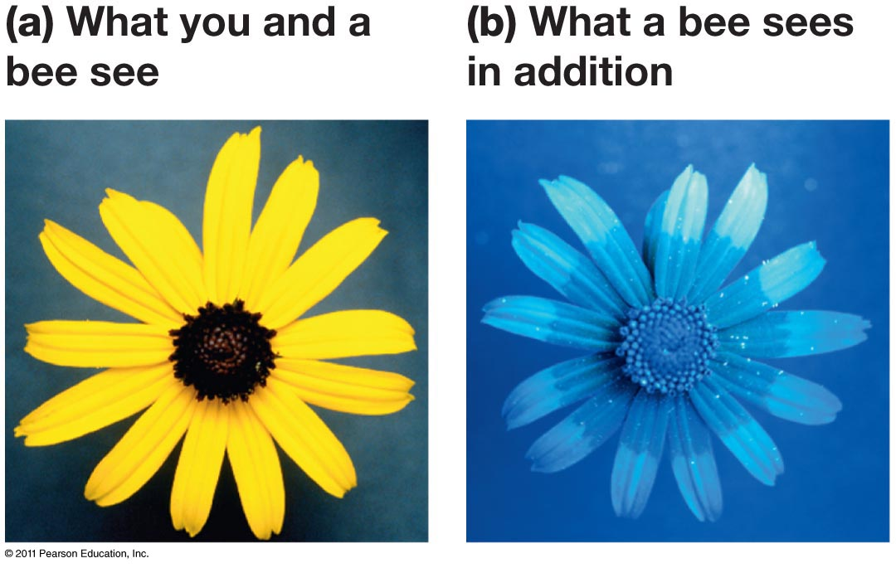
Pollination syndromes
Flower characteristics associated with certain types of pollinators
Wind: mass-produced, low chance of success
Animal pollinators: less produced, much higher chance of success; often tight co-evolution
Birds: active during day, respond to visual stimuli
Bees/butterflies/wasps: active during day, respond to visual and olfactory stimuli
Moths: active during night, respond to visual and olfactory stimuli
Bats: active during night, respond to visual and olfactory stimuli
Nectar = “cost” of sex

Slide 16
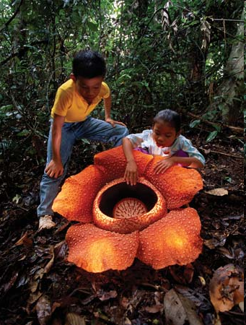
Rafflesia, The “ Monster Flower”

Slide 17
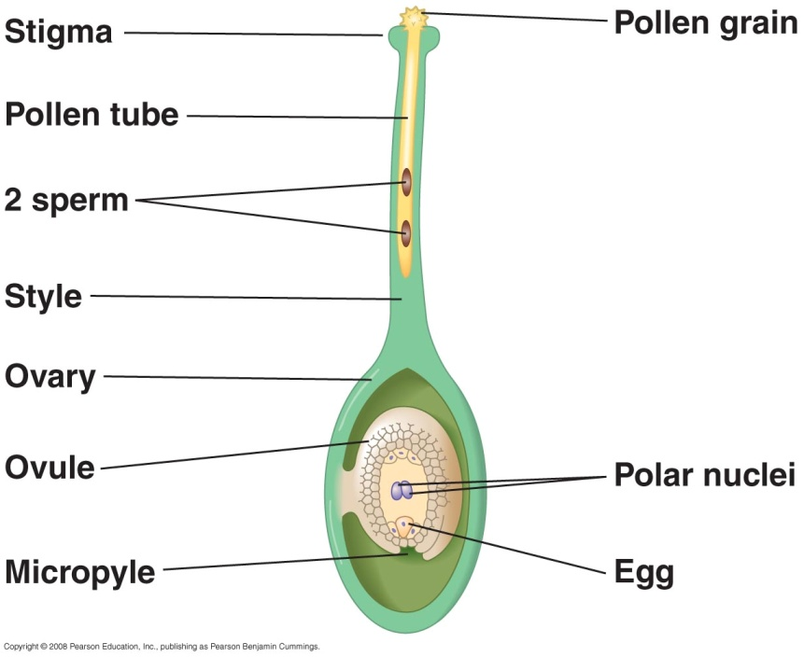
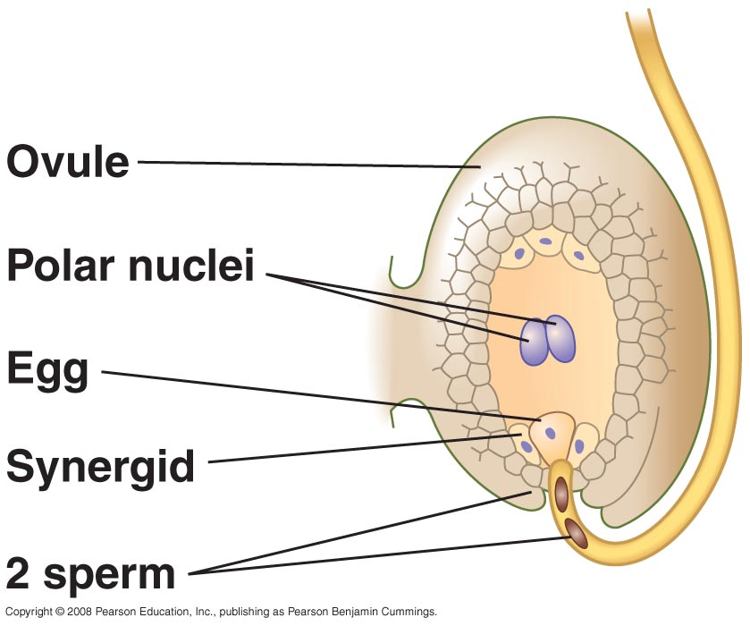
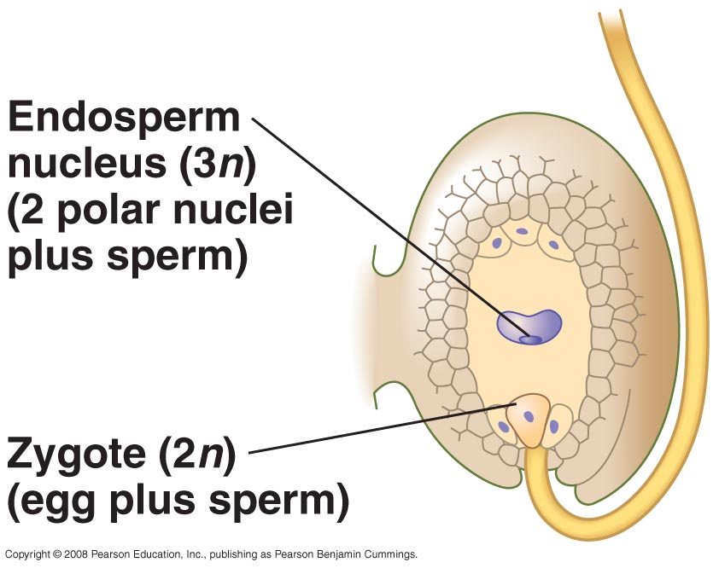
Angiosperm double fertilization
Antipodal and synergid cells (1n)
http://www.youtube.com/watch?v=bUjVHUf4d1I
http://bcs.whfreeman.com/thelifewire/content/chp39/3902001.html
Campbell & Reece, Fig. 38.02
Notes:
If a pollen grain germinates, a pollen tube grows down the style toward the ovary.
The pollen tube discharges two sperm into the female gametophyte (embryo sac) within an ovule.
One sperm fertilizes the egg, forming the zygote. The other sperm combines with the two polar nuclei of the embryo
sac’s large central cell, forming a triploid cell that develops into the nutritive tissue called endosperm.
17

Slide 18
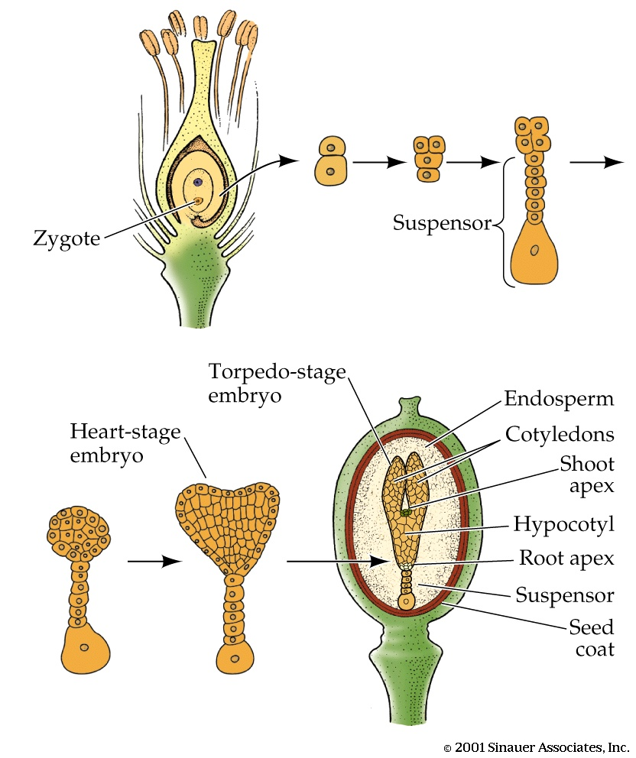
Embryo Development Within Seed post-fertilization; pre-germination
Embryo proper
Zygote divides asymmetrically, each cell has a different fate
Apical cell to form embryo proper
Basal cell forms suspensor
Polarity and the longitudinal axis are established by this asymmetric division
globular stage

Slide 19
Embryo Development Within Seed
As cotyledons elongate, internal tissue starts to differentiate
Elongating region below cotyledons is the hypocotyl
Between hypocotyl and cotyledons is the shoot apex, the root apex is at the other end,
each contains an apical meristem which will give rise to organs in the mature plant
Next steps: dormancy, dispersal, germination
Embryo proper
globular stage

Slide 20
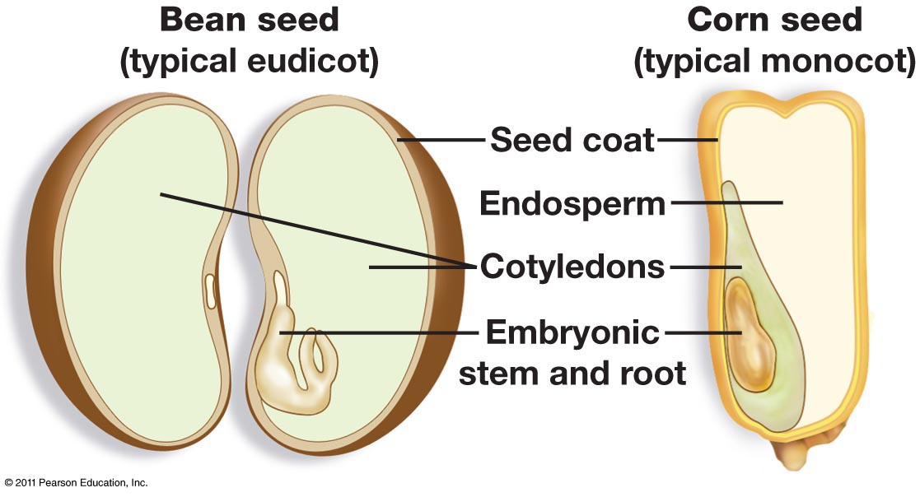
Endosperm & Cotyledon Accumulate Storage Products to Sustain Embryo Growth & Development
Starch, lipids and proteins accumulate in endosperm
At late stage of development, seed loses water (up to 95% original water lost) and enters quiescent state (dormancy)
Imbibition of water is a necessary step for germination

Slide 21
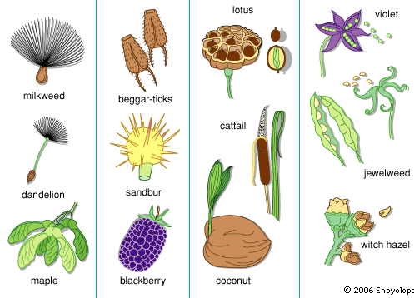
Seed maturation, fruits, and dispersal
Seed desiccation (drying)
Essential for seed maturation
Concentrated sugars preserve cell structure and protect from freezing
Fruit function
Protect from predators and damage
Aid in seed dispersal
Dispersal mechanisms
Dropping
Wind
Propulsion
Animals
Water
Mammals vs birds as seed dispersers
Mammals = active at night; well-developed sense of smell
Birds = active during day; well-developed sense of sight
Notes:
Predict features of seeds each dispersal mechanism
http://www.abundantnature.com/2011/10/wild-violets-explosive-seed-dispersal.html

Slide 22
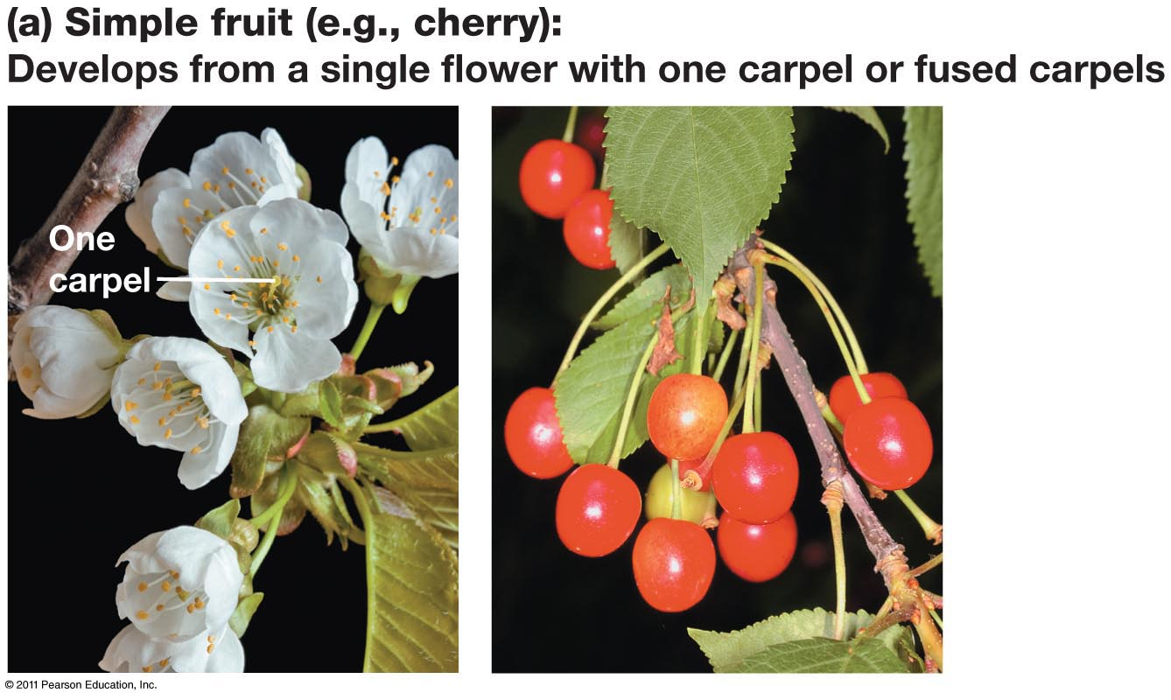
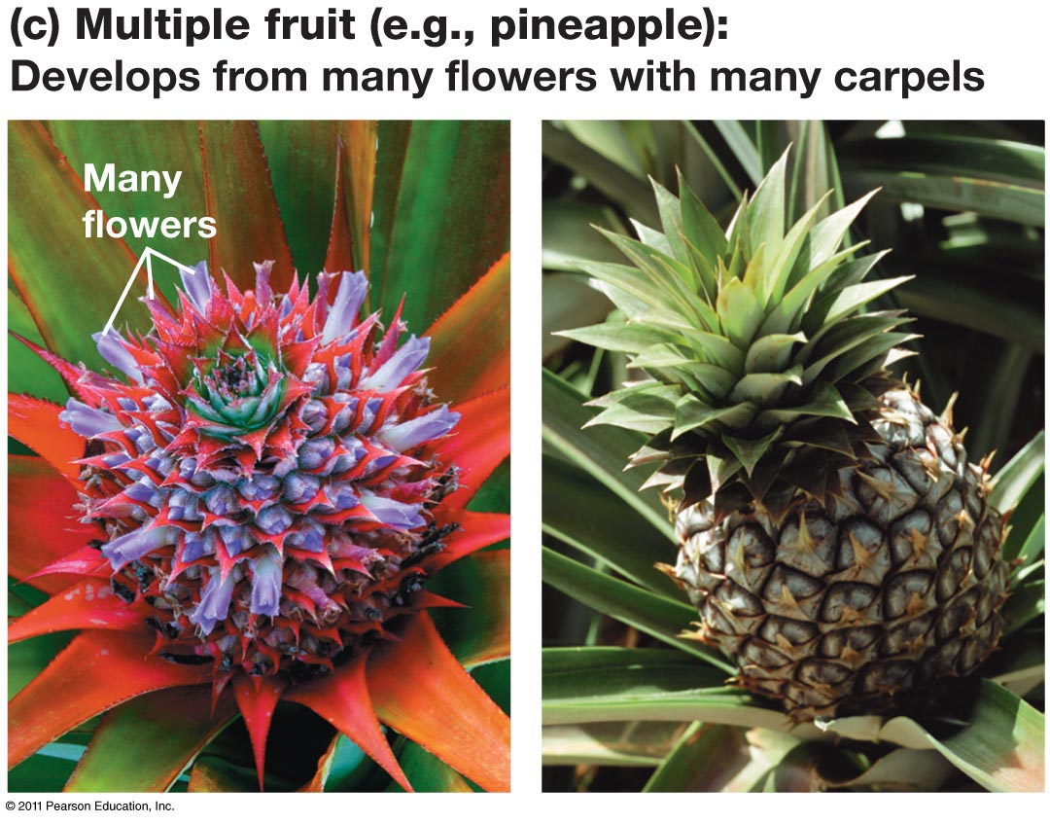
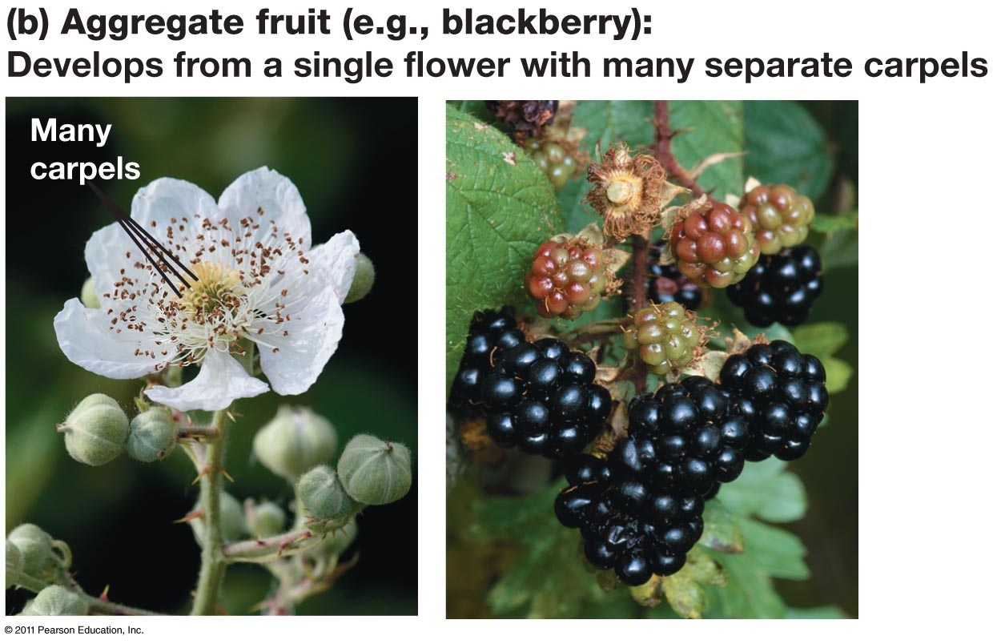
From Ovary to Fruit for Dispersal
A fruit: develops from the ovary, protects the enclosed seeds, and aids in the dispersal of seeds by wind or animals

Slide 23
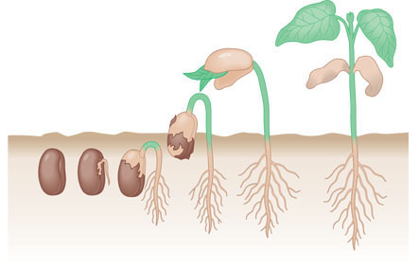
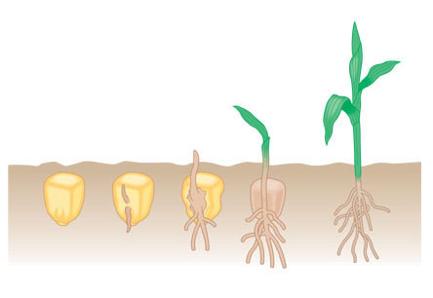
Seed dormancy & germination
Foliage leaves
Cotyledon
Dormancy may be broken by
Scarification
Fire
Light (specific wavelengths)
Germination process
Phase I
Rapid influx of water (down concentration gradient)
Metabolism and protein synthesis without new mRNA transcription
Phase II
Water uptake stops
New mRNA transcription, more metabolism protein synthesis
Phase III
Water uptake resumes
Seedling bursts from seed coat
Epicotyl
Hypocotyl
Cotyledon
Hypocotyl
Cotyledon
Hypocotyl
Radicle
Seed coat
Common garden beans
Foliage leaves
Coleoptile
Coleoptile
Radicle
Maize

